Slide 1
Employee Salary Prediction using Machine Learning Algorithm
CAPSTONE PROJECT
Presented By:
1. Student Name-Akshay Ananta Besekar
2. College Name-PES Modern Insitute of Business Studies Nigdi, Pune

Slide 2
OUTLINE
Problem Statement (Should not include solution)
System Development Approach (Technology Used)
Algorithm & Deployment (Step by Step Procedure)
Result
Conclusion
References

Slide 3
Problem Statement
In today’s data-driven workforce, predicting employee income levels based on personal and professional attributes is crucial for informed decision-making in HR and business analytics. Organizations often deal with large datasets containing various factors like education, work experience, job role, and demographics, which influence salary outcomes. However, identifying patterns and accurately classifying income groups from such high-dimensional and often imbalanced data is a significant challenge. Manual analysis is time-consuming and error-prone, making automation necessary. This project aims to address the classification problem of predicting whether an employee earns above or below a certain salary threshold based on given features, without human bias.

Slide 4
System Approach
Programming Language: Python
Data Processing Libraries: pandas
Visualization: matplotlib
Preprocessing: LabelEncoder, MinMaxScaler from sklearn
Machine Learning Algorithms:
K-Nearest Neighbors (KNN)
Logistic Regression
Multi-layer Perceptron Classifier (MLP)
Model Evaluation: accuracy_score from sklearn.metrics
Development Environment: Jupyter Notebook (with local runtime)

Slide 5
Algorithm & Deployment
Data Collection:
Loaded the adult.csv dataset containing attributes such as age, education, occupation, race, gender, hours per week, etc.
Data Cleaning & Preprocessing:
Handled missing values by replacing unknowns (e.g., ?) with Others or Notlisted.
Removed non-informative or noisy entries like “Without-pay”, “Never-worked”.
Removed low-frequency educational categories like “Preschool”, “1st-4th”, etc.
Dropped redundant columns like education (retaining educational-num).

Slide 6
Encoding:
Used Label Encoding for categorical features like workclass, marital-status, occupation, gender, etc.
Feature Scaling:
Applied MinMaxScaler to normalize numerical data for consistent model input.
Data Splitting:
Split data into training and testing sets (80% train, 20% test) using train_test_split.

Slide 7
Model Building & Training:
Trained three different ML models:
K-Nearest Neighbors (KNN)
Logistic Regression
Multi-layer Perceptron (MLP)
Prediction & Evaluation:
Generated predictions on test data.
Evaluated performance using accuracy scores:
KNN: ~81.67%
Logistic Regression: ~81.97%
MLP Classifier: ~83.91%

Slide 8
Result
Among the three models used, the MLP Classifier achieved the highest accuracy of ~83.91%, outperforming both Logistic Regression and KNN classifiers. The results indicate that neural network-based models can capture more complex patterns in the salary prediction problem than simpler models.

Slide 9
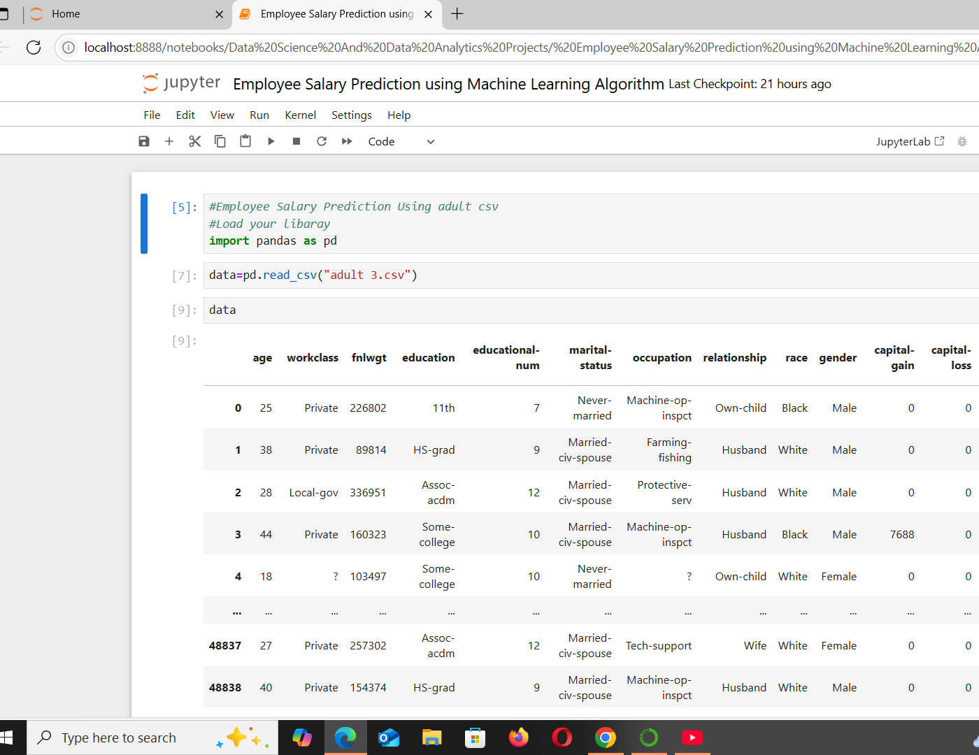
Screen snaps of the code and output min 5

Slide 10
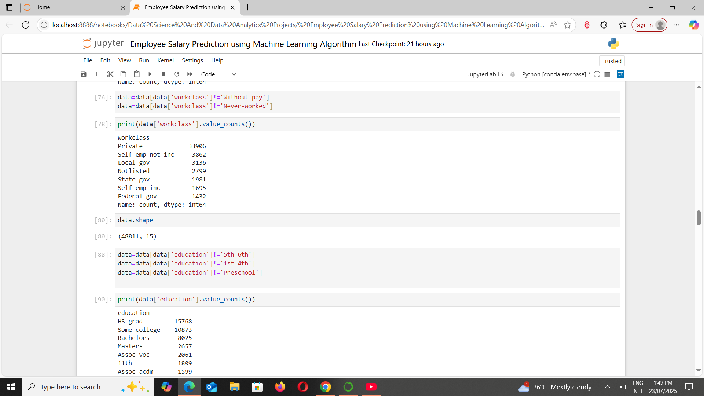

Slide 11
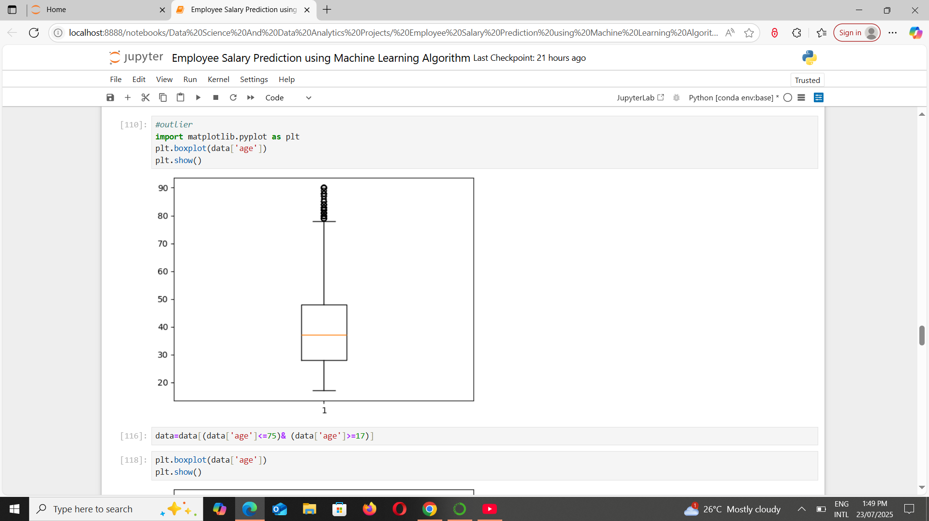
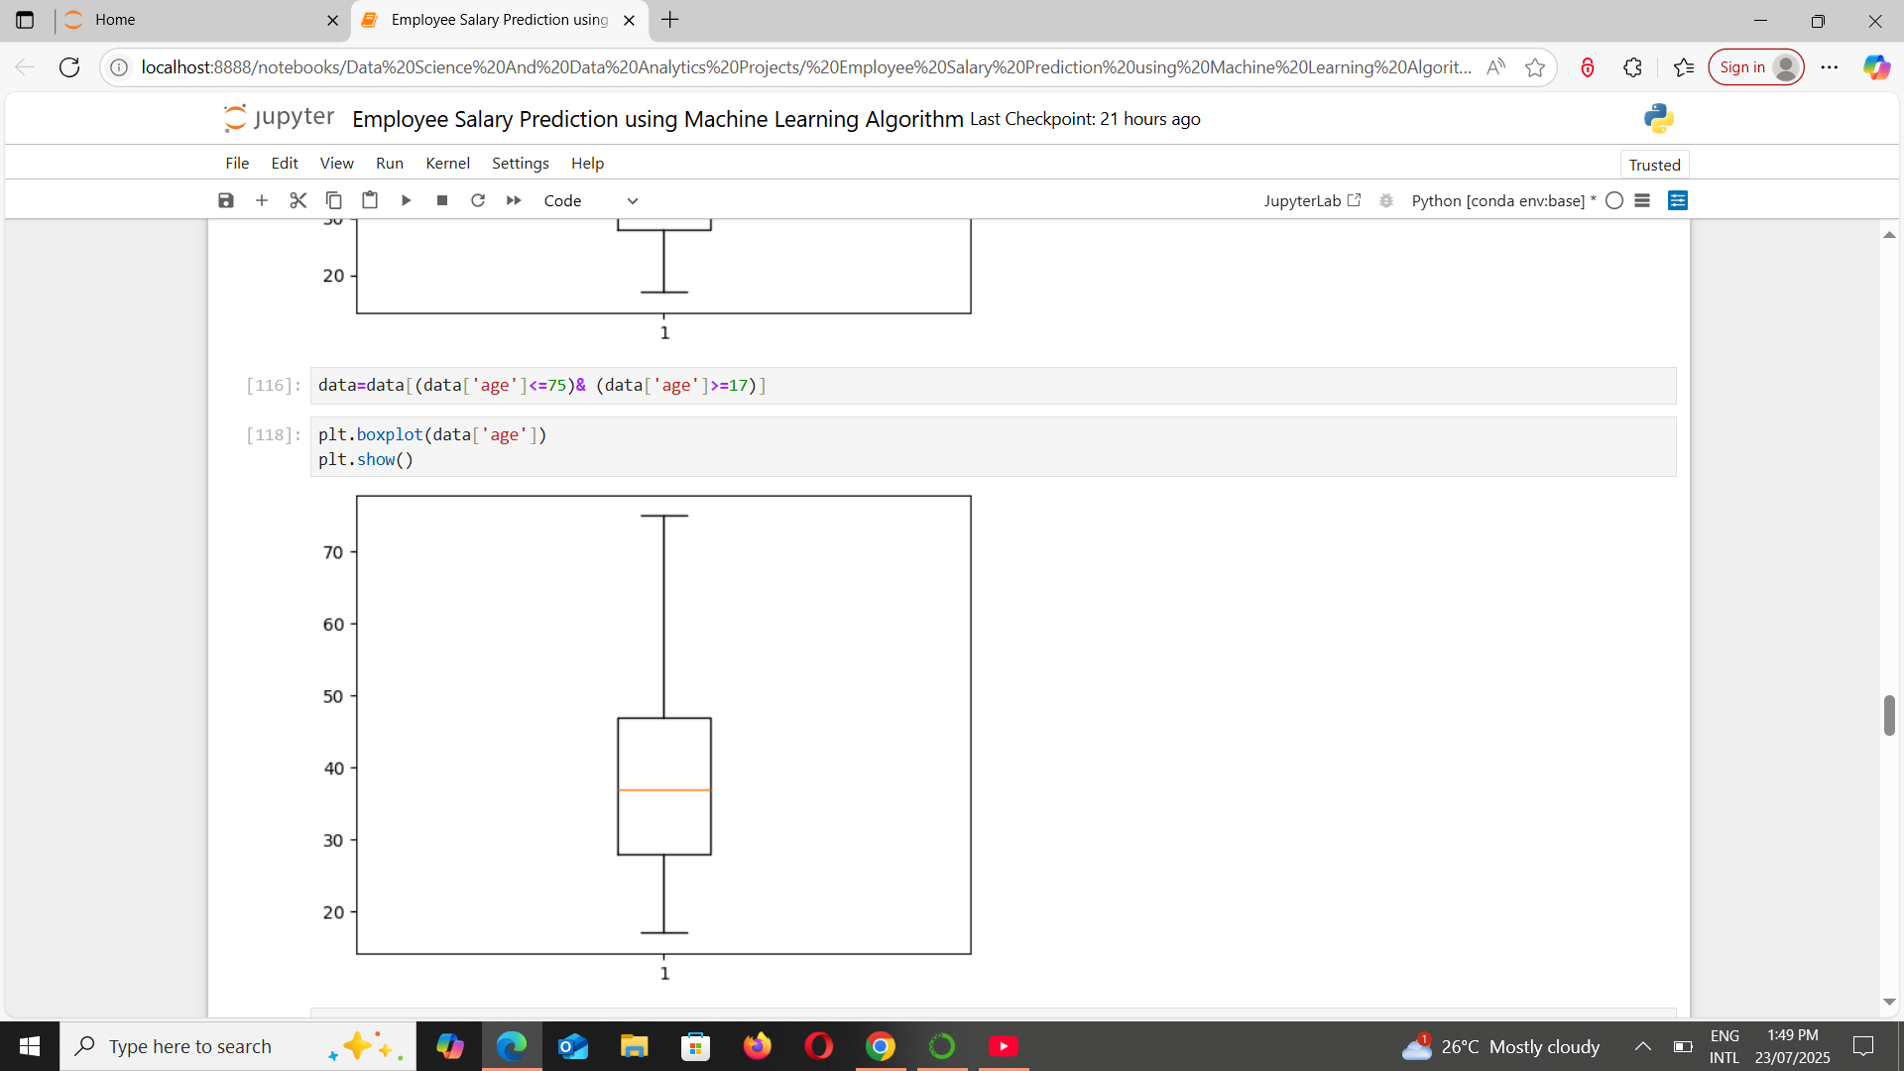

Slide 12
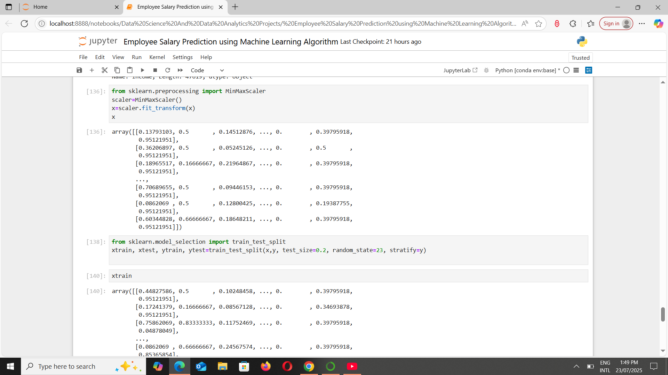
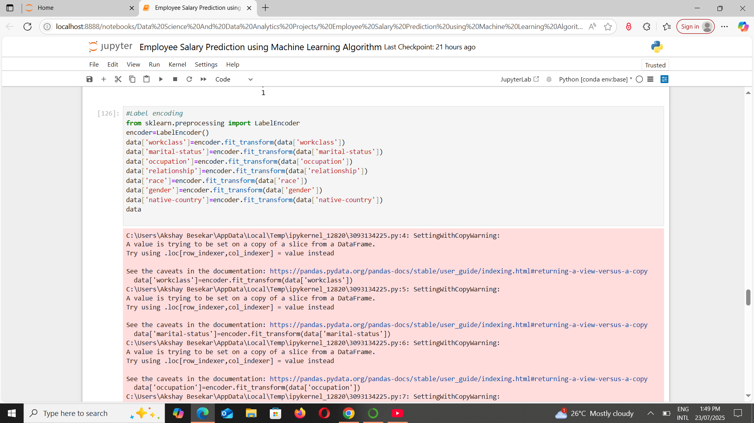

Slide 13
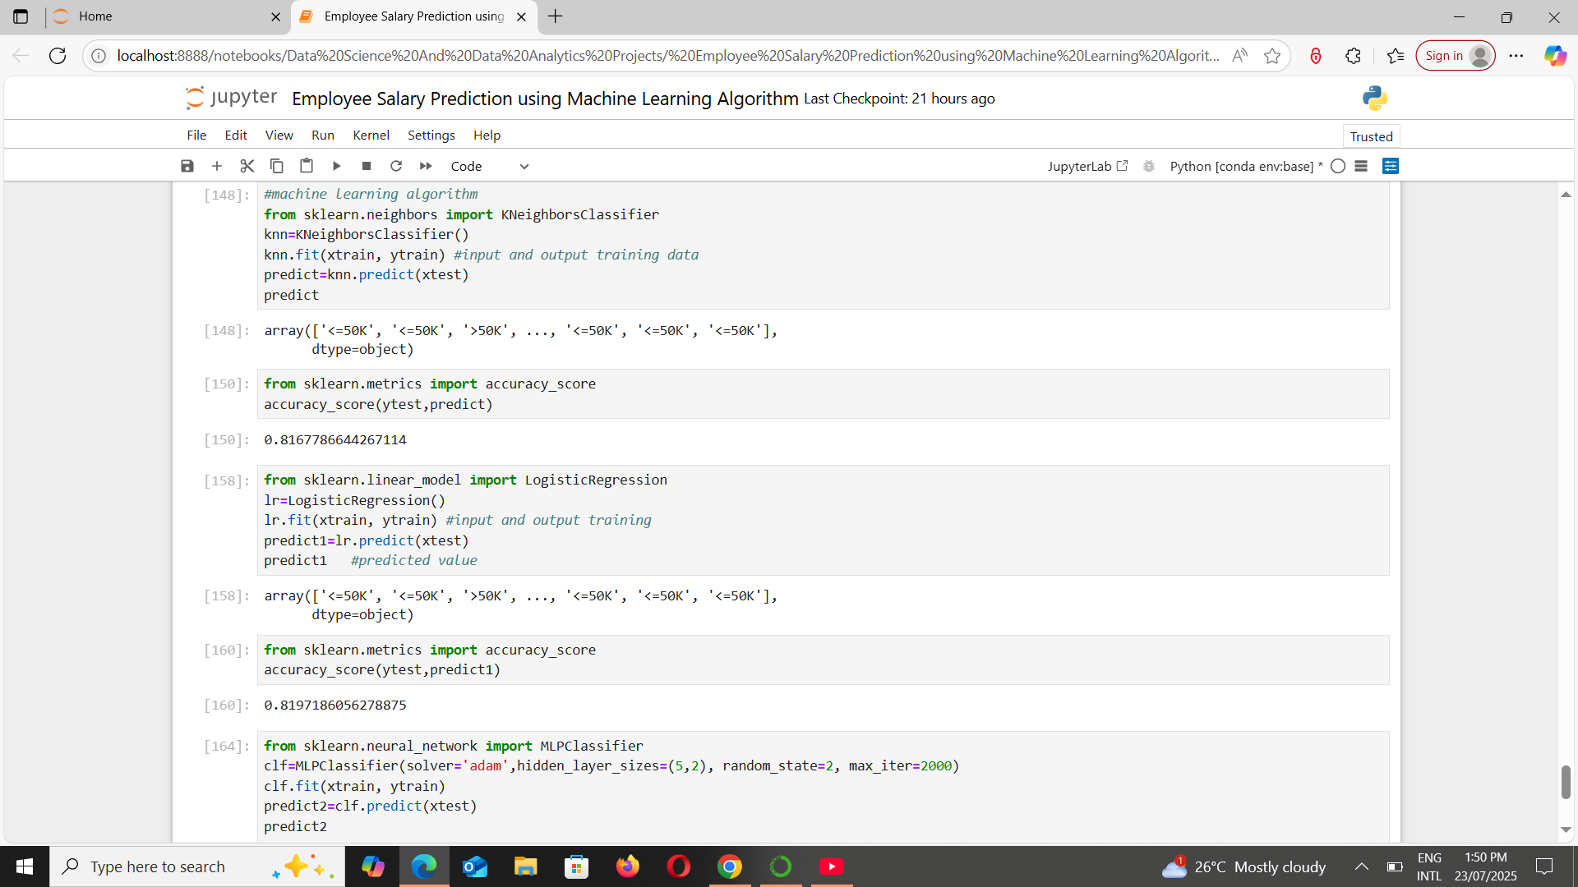
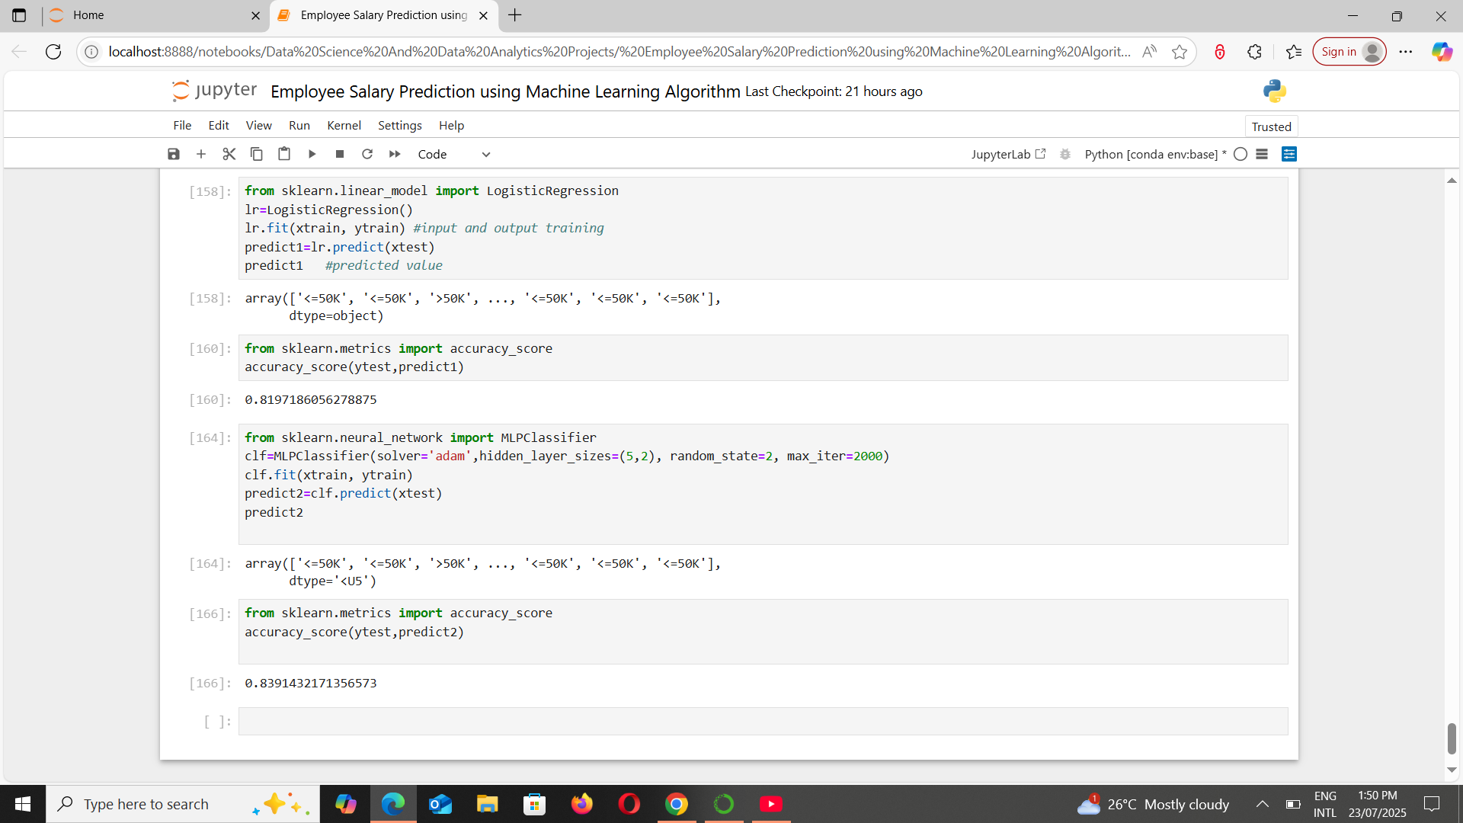

Slide 14
Github link
https://github.com/Akshay01-B

Slide 15
Conclusion
The project effectively demonstrated how machine learning algorithms can be applied to predict employee salary categories based on demographic and job-related features. Among the models tested, the Multi-layer Perceptron (MLP) classifier achieved the highest accuracy (~83.91%), indicating that neural networks can capture complex patterns in income classification better than traditional algorithms like K-Nearest Neighbors and Logistic Regression.

Slide 16
However, several challenges were encountered during the implementation:
The dataset included numerous missing or unknown entries (e.g., '?') thatrequired manual handling.
Class imbalance slightly impacted the model’s predictive power, especially indetecting the minority class (income >50K).
Multiple iterations were needed to tune preprocessing steps such as labelencoding, outlier handling, and feature selection.

Slide 17
References
UCI Machine Learning Repository: Adult Income Dataset
Scikit-learn Documentation: https://scikit-learn.org/
Pandas Documentation: https://pandas.pydata.org/
Matplotlib Documentation: https://matplotlib.org/
Python Official Documentation: https://docs.python.org/3/

Slide 18
THANK YOU

